Slide 1
SUPERSTORE ANALYTICS DASHBOARD

Slide 2
OVERVIEW:
The dashboards reveal a detailed picture of the superstore's sales and profit performance across different segments and regions. A key takeaway is that while the business is profitable overall, there are significant regional and category-specific disparities that require strategic attention.

Slide 3
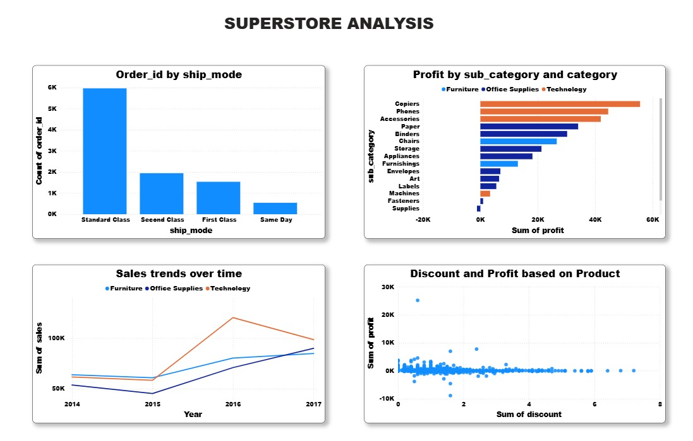

Slide 4
Dashboard 1: Overall Performance & Customer Segmentation
This dashboard provides a high-level overview of sales, profit, and customer behavior. It highlights key metrics and breaks down performance by customer segment.
Key Takeaways & Business Insights
Positive Overall Profitability: The company is profitable with a 31.3% profit ratio. Total sales stand at approximately 2.3 million, generating over 286,000 in profit. This indicates a healthy business model.
Dominant Consumer Segment: The Consumer segment is the largest contributor to both sales 1.2 million and profit 134,119. This customer group represents the core of the business and is likely the most reliable source of revenue.
Corporate Segment's Potential: The Corporate segment contributes a significant amount to sales 706,146 and profit 91,979 , but with a slightly higher profit ratio of 13% compared to the Consumer segment's 11%. This suggests that corporate customers, while fewer in number, are more profitable on average.
Home Office Segment: The Home Office segment has the highest profit ratio at 16%, despite being the smallest segment in terms of both sales and profit. This indicates that transactions with this segment are highly efficient and profitable.

Slide 5
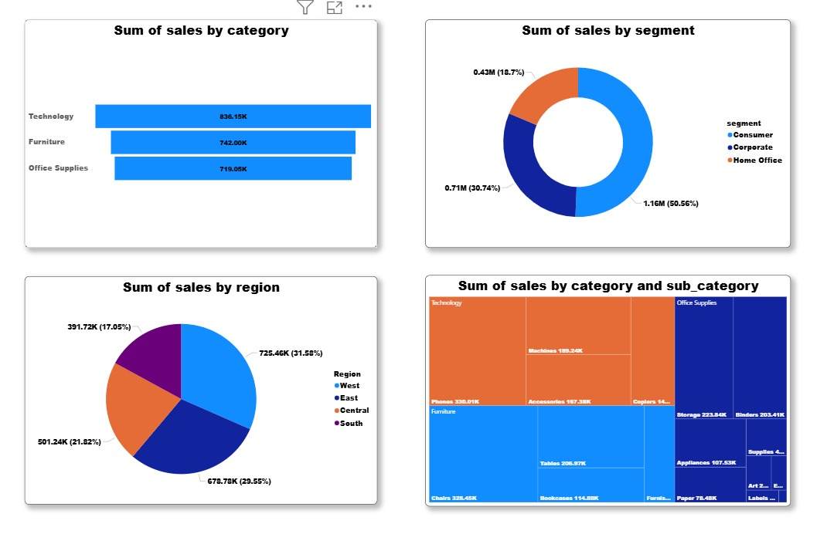

Slide 6
Dashboard 2: Regional Performance & Product Analysis
This dashboard provides a granular view of performance by region and dives into the profitability of different product categories.
Key Takeaways & Business Insights
Regional Disparities: The West and East regions are the top performers, contributing the most to both sales and profit. They are the primary growth engines for the business.
Southern Slump: The South region has the lowest profit ratio and is a drag on overall profitability. While it generates decent sales, the profit margins are weak, suggesting that high discounts or inefficient operations are impacting its performance. A deep dive into this region's specific states and cities is warranted to identify and resolve these issues.
Loss-Making Products: The Tables and Bookcases sub-categories are a major concern. They have negative profits of -17,725 and -3,473, respectively. This is a critical issue that needs immediate attention. The high sales from these items may be misleading if they're consistently sold at a loss. It's crucial to investigate if these products are being heavily discounted or if their costs are too high.

